Slide 1
MAJOR PROJECT PRESENTATION

Slide 2
TITLE OF MAJOR PROJECT
Prognosis of Breast Cancer Using Machine Learning Algorithms
Submitted By:-
Shivangi Gaur VII C (1900290100144)
Vasu Bansal VII C
(1900290100186)
Guided By :-
Dr. Seema Maitrey

Slide 3
Breast Cancer: An Overview
Breast cancer has now overtaken lung cancer as the most commonly diagnosed cancer in women worldwide.
Breast cancer is a type of cancer that originates in the breast tissue. It primarily affects women, although men can also develop breast cancer, albeit at a much lower rate. It is the most common cancer among women worldwide.
Today, one in 5 people worldwide will develop cancer during their lifetime. Projections suggest that cases will be nearly 50% higher in 2040 than in 2020.
The number of cancer deaths has also increased, from 6.2 million in 2000 to 10 million in 2020. More than one in six deaths is due to cancer.
Breast cancer occurs when the cells in the breast begin to grow abnormally and uncontrollably, forming a tumor.

Slide 4
These tumors can be either malignant (cancerous) or benign (non-cancerous). Malignant tumors have the potential to invade nearby tissues and spread to other parts of the body through the bloodstream or lymphatic system.
Early detection is crucial for successful treatment and improved outcomes. Regular breast self-exams, clinical breast exams by healthcare professionals, and mammograms are important screening tools for detecting breast cancer.
Treatment options for breast cancer depend on various factors, including the stage of the cancer, the type of breast cancer, and the individual's overall health. Common treatment modalities include surgery (lumpectomy or mastectomy), radiation therapy, chemotherapy, hormone therapy, targeted therapy, and immunotherapy. Treatment plans are often tailored to the specific needs of each patient and may involve a combination of these approaches.
Breast cancer awareness and education are essential for early detection and prevention.

Slide 5
WHY BREAST CANCER WE CHOOSE?
As of 2019, on average, 1 in 8 U.S women (approx. 12%) would develop invasive breast cancer at some point during her life.
5-year survival rate for breast cancer is 100% with early detection and 15% with late detection (UK Cancer research)
It is the second largest disease that is responsible of women death.
In the case of breast cancer, machine learning techniques can be used to distinguish between malignant and benign tumors for enabling early detection.
Projects focused on breast cancer often emphasize the importance of regular screenings, self-exams, and awareness of symptoms.

Slide 6
By promoting early detection and treatment, projects can help save lives and improve outcomes for individuals diagnosed with breast cancer.
By choosing breast cancer as a project topic, individuals and organizations can make a meaningful contribution to raising awareness, promoting early detection, supporting patients and their families, and advancing research efforts to combat this prevalent and impactful disease.

Slide 7
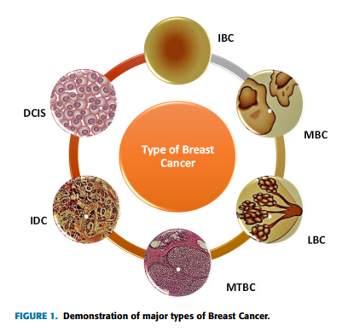
Types of Breast Cancer
Ductal Carcinoma in Situ – DCIS is type of the breast cancer that occurs when abnormal cells spread outside the breast it is also known as the non-invasive cancer.
Invasive Ductal Carcinoma – IDC is also known as infiltrative ductal carcinoma .This type of the cancer occurs when the abnormal cells of breast spread over all the breast tissues and IDC cancer is usually found in men.
Mixed Tumors Breast Cancer - MTBC is known as invasive mammary breast cancer .Abnormal duct cell and lobular cell causes such kind of cancer.

Slide 8
Lobular Breast Cancer- LBC which occurs inside the lobule. It increases the chances of other invasive cancers.
Mucinous Breast Cancer -MBC is also known as colloid breast cancer. It occurs when the abnormal tissues spread around the duct.
Inflammatory Breast Cancer – IBC is last type that causes swelling and reddening of breast. It is a fast growing breast cancer, when the lymph vessels block in break cell, this type of cancer starts to appear.

Slide 9
Define Problem
The problem of inaccurate breast cancer detection among women affects of the incurable victims of breast cancer and the doctors who are now able to identify the illness in its early stage which results the late diagnosis of the disease. In the later stage in which cancer has affected a large portion of the patient organ.
A benefit of classifier would help us into detecting breast cancer among women based on the attributes that are present in dataset.
By promoting early detection and treatment, projects can help save lives and improve outcomes for individuals diagnosed with breast cancer.

Slide 10
Objectives
Finding the most suitable and appropriate algorithm of Machine Learning for the prediction of breast cancer is one of the important task.
Which factors are most important for classification of breast cancer outcomes.
To classify of breast cancer into benign and malignant using machine learning system
Build an App which is user friendly and predict breast cancer in early stage .
Prediction models can classify individuals into different risk groups based on their likelihood of developing breast cancer.
The most important objective is saving HUMAN LIFE.

Slide 11
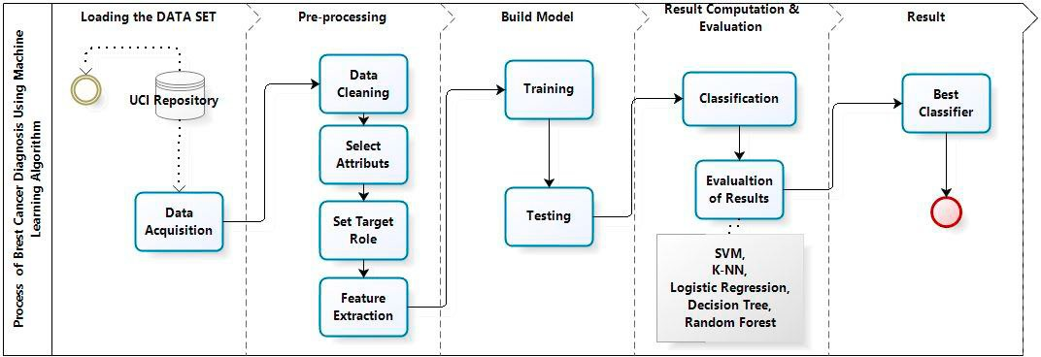
Process Flow Diagram
Fig 1 [16]

Slide 12
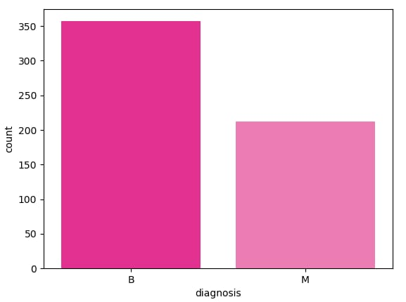
Data Acquisition
In our study, we use Breast Cancer Wisconsin Diagnostic dataset from University of Wisconsin Hospitals Madison Breast Cancer Database .
The features of dataset are computed from a digitized image of a breast cancer sample obtained from fine-needle aspirate (FNA).
The characteristics of the cell nuclei present in the image are determined from these features.
Breast Cancer Wisconsin Diagnostic has 569 instances (Benign: 357 Malignant: 212), 2 classes (62.74% benign and 37.26% malignant), and
11 integer-valued attributes (-Id -Diagnosis -Radius - Texture -Area -Perimeter -Smoothness -Compactness -Concavity -Concave points -Symmetry -Fractal dimension).
Fig 2.[16] WISCONSIN BREAST CANCER DIAGNOSTIC DATASETS.

Slide 13
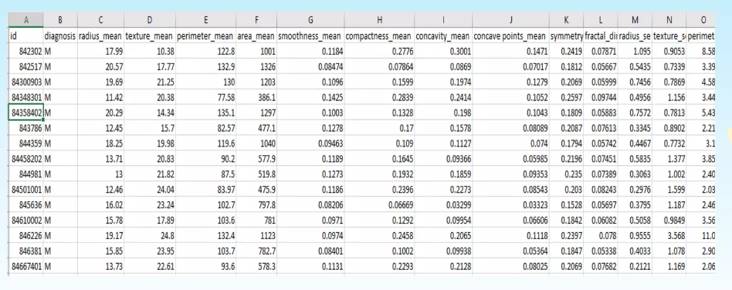
Taking a view of Biopsy Data

Slide 14
Experiment Environment
Experiments on the machine learning algorithms described during this paper were conducted using Scikitlearn library and Python programming language.
Scikit-learn also known as sklearn is a free software machine learning library for the Python programming language.
It features various classification, regression and clustering algorithms including support vector machines, random forests, gradient boosting, k-means and DBSCAN, and is designed to interoperate with the Python numerical and scientific libraries NumPy and SciPy.

Slide 15
Machine Learning Algorithm
S no | Algorithm | Description
1 | Support Vector Machine | It is a classifier which divides the datasets into classes to find a maximum marginal hyper plane (MMH) via the nearest data points .
2 | Random forests | Random forests are an ensemble method for classification, regression and other tasks, that operate by constructing a multitude of decision trees at training time and outputting the class that is the mode of the classes (classification) or mean prediction (regression) of the individual trees.
3 | Decision Tree | Decision Tree C4.5 is a predictive modeling tool that can be applied across many areas. It can be constructed by an algorithmic approach that can split the dataset in different ways based on different conditions .
4 | Logistic Regression | Logistic regression is a very powerful modeling tool, is a generalization of linear regression . Logistic Regression is used to assess the likelihood of a disease or health condition as a function of a risk factor . It is used primarily for predicting binary or multiclass dependent variables.
5 | K-Nearest Neighbors | k-Nearest Neighbors (K-NN) is a supervised classification algorithm. It takes a bunch of labeled points and uses them to learn how to label other points.

Slide 16
Overall Result
After applying Machine Learning Algorithms on Breast Cancer Wisconsin Diagnostic dataset. We used Confusion Matrix, Accuracy, Precision, Sensitivity, F1 Score, AUC as performance metrics to evaluate and compare the models and identify the best algorithm for the breast cancer Prediction.
Confusion Matrix is the way to measure the performance of a classification problem where the output can be of two or more type of classes.
A confusion matrix is a table with two dimensions viz. “Actual” and “Predicted” and furthermore, both the dimensions have “True Positives (TP)”, “True Negatives (TN)”, “False Positives (FP)”, and “False Negatives (FN)”.
Accuracy is most common performance metric for classification algorithms. It defined as the number of correct predictions made as a ratio of all predictions made.
Precision, used in document retrievals, may be defined as the number of correct documents returned by our ML model.

Slide 17
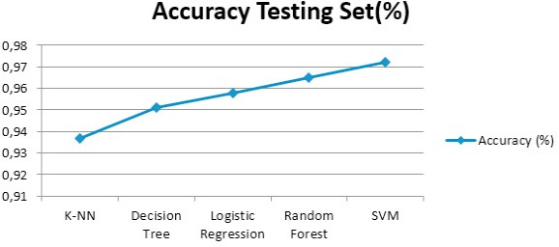
Table 1 and figure 1 show the accuracy percentage for Wisconsin Breast Cancer Diagnostic datasets. From the results of training set and testing set we can see that all the classifiers have varying accuracies but SVM always has higher accuracy testing set (97.2%) than the other classifiers.
Fig. 1 Comparative graph of different classifiers

Slide 18
Result Table
Table 1. Accuracy percentage for breast cancer diagnostic dataset
Algorithms | Accuracy training set(%) | Accuracy Testing Set(%)
SVM | 98.4 | 97.2
Random Forest | 99.8 | 96.5
Logistic Regression | 95.5 | 95.8
Decision Tree | 98.8 | 95.1
K-NN | 94.6 | 93.7
We employed five main algorithms: SVM, k-NN,DT,RF and LR on the Wisconsin Breast Cancer (original) datasets.
We tried to compare efficiency and effectiveness of those algorithms in terms of accuracy, precision, sensitivity and specificity to find the best classification accuracy. of SVM reaches and accuracy of 97.2% and outperforms, therefore, all other algorithms. In conclusion, SVM has proven its efficiency in Breast Cancer prediction and diagnosis and achieves the best performance in terms of precision and low error rate.

Slide 19
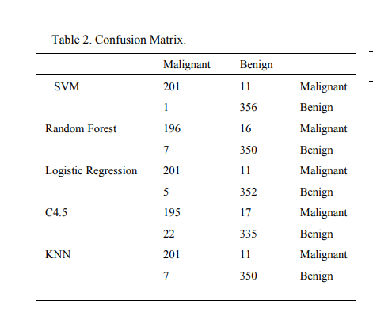
Since confusion matrices are a useful way to assess the classifier, each row in Table 2 represents the rates in an actual class while each column displays the predictions. Table 3 present the calculated performance measures of classification models based on confusion matrix results, precision sensitivity f1 score for benign and malignant.

Slide 20
Table 2 Confusion matrix shows that Support Vector Machine predicts correctly 556 cases out of 569 cases constituted of 201 malignant cases that are actually malignant and 356 benign cases that are actually benign, and 11 cases incorrectly predicted including 11 cases of malignant class predicted as benign and 1 case of benign class predicted as malignant.
That is why the accuracy of Support Vector Machine is better than other classification techniques. From the results of table we can see that the percentages of precision 0.98%, sensitivity 0.94%, F-Measure 0.96% of SVM is higher than that of other classifiers.
SVM always outperforms than the other classifiers in performance for two class malignant and benign in Breast Cancer Wisconsin Diagnostic dataset cancer.

Slide 21
Attributes that yield best result for SVM
There are 9 attributes(features) that yield the best result for SVM algorithm.These attributes found to be informative and influential for breast cancer classification using SVM.
Radius Mean: The radius of a tumor is a measure of its size. Larger tumors tend to be associated with a higher likelihood of malignancy. In breast cancer prediction, the radius_mean feature provides information about the size of the tumor, which can be indicative of its potential malignancy.
Texture Mean: Texture refers to the variations in grayscale intensities within the image of a tumor. Tumors with heterogeneous texture patterns may indicate irregular growth patterns and increased likelihood of malignancy. The texture_mean feature captures this information, which can be helpful in differentiating between benign and malignant tumors.

Slide 22
Perimeter: The perimeter of a tumor measures the length of its boundary. Similar to the radius, tumors with larger perimeters are generally associated with a higher probability of malignancy. The perimeter_mean feature provides information about the shape and extent of the tumor, which can contribute to accurate classification.
Area: The area of a tumor represents the size of the tumor in terms of the number of pixels or units. Similar to the radius and perimeter, a larger tumor area is often associated with increased malignancy. The area_mean feature provides a quantitative measure of the tumor's size, which can contribute to accurate classification.
Smoothness: Smoothness is a measure of the local variation in the radius of a tumor. Malignant tumors tend to have irregular and rough surfaces, resulting in lower smoothness values. The smoothness_mean feature captures this aspect and can help distinguish between benign and malignant tumors.
Compactness: Compactness measures the shape of a tumor by comparing its perimeter to its area. Tumors with irregular shapes often have higher compactness values. The compactness_mean feature can capture the irregularity of tumor shape, which is often associated with malignancy.

Slide 23
Concavity: Concavity refers to the presence of concave regions within the boundary of a tumor. Higher concavity values are typically observed in malignant tumors due to irregular growth patterns. The concavity_mean feature provides information about the concave regions within the tumor, which can contribute to accurate classification
Concave points: Concave points represent the number of concave portions in the boundary of a tumor. Malignant tumors often have more concave points compared to benign tumors. The concave points_mean feature captures this characteristic and can help differentiate between benign and malignant tumors.
Symmetry: Symmetry measures the symmetry of a tumor in terms of its shape and appearance. Benign tumors tend to have higher symmetry values, while malignant tumors may exhibit more asymmetry. The symmetry_mean feature provides information about the tumor's symmetry, which can be useful for accurate classification.
These attributes are part of the Wisconsin Diagnostic Breast Cancer (WDBC) dataset, which contains various measurements derived from digitized images of breast mass.

Slide 24
CONCLUSION
On the Wisconsin Breast Cancer Diagnostic dataset (WBCD) we applied five main algorithms which are: SVM, Random Forests, Logistic Regression, Decision Tree, K-NN, calculate, compare and evaluate different results obtained based on confusion matrix, accuracy, sensitivity, precision, AUC to identify the best machine learning algorithm that are precise, reliable and find the higher accuracy.
All algorithms have been programmed in Python using scikit-learn library in Anaconda environment.
After an accurate comparison between our models, we found that Support Vector Machine achieved a higher efficiency of 97.2%, Precision of 97.5%, AUC of 96.6% and outperforms all other algorithms.

Slide 25
In conclusion, Support Vector Machine has demonstrated its efficiency in Breast Cancer prediction and diagnosis and achieves the best performance in terms of accuracy and precision.
It should be noted that all the results obtained are related just to the WBCD database, it can be considered as a limitation of our work, it is therefore necessary to reflect for future works to apply these same algorithms and methods on other databases to confirm the results obtained via this database, as well as, in our future works, we plan to apply our and other machine learning algorithms using new parameters on larger data sets with more disease classes to obtain higher accuracy.

Slide 26
REFERENCES
[1] ‘WHO | Breast cancer’, WHO. http://www.who.int/cancer/prevention/diagnosis-screening/breast-cancer/en/ (accessed Feb. 18, 2020).
[2] Datafloq - Top 10 Data Mining Algorithms, Demystified. https://datafloq.com/read/top-10-data-mining-algorithmsdemystified/1144. Accessed December 29, 2015.
[3] S. Nayak and D. Gope, "Comparison of supervised learning algorithms for RF-based breast cancer detection," 2017 Computing and Electromagnetics International Workshop (CEM), Barcelona, 2017, pp 1-
[4] B.M. Gayathri and C. P. Sumathi, "Comparative study of relevance vector machine with various machine learning techniques used for detecting breast cancer," 2016 IEEE International Conference on Computational Intelligence and Computing Research (ICCIC), Chennai, 2016, pp. 1-5.
[5] H. Asri, H. Mousannif, H. A. Moatassime, and T. Noel, ‘Using Machine Learning Algorithms for Breast Cancer.
Risk Prediction andDiagnosis’, Procedia Computer Science, vol. 83, pp. 1064–1069, 2016, doi: 10.1016/j.procs.2016.04.224.

Slide 27
[6] Y. khoudfi and M. Bahaj, Applying Best Machine Learning Algorithms for Breast Cancer Prediction and Classification, 978-1-5386- 4225- 2/18/$31.00 ©2018 IEEE.
[7] L. Latchoumi, T. P., & Parthiban, “Abnormality detection using weighed particle swarm optimization and smooth support vector machine,”Biomed. Res., vol. 28, no. 11, pp. 4749–4751, 2017.
[8] Biomed. Res., vol. 28, no. 11, pp. 4749–4751, 2017.
[9] A. H. Osman, “An Enhanced Breast Cancer Diagnosis Scheme based on Two-Step-SVM Technique,” Int. J. Adv. Comput. Sci. Appl., vol. 8, no. 4, pp. 158–165, 2017.
[10] Noble WS. What is a support vector machine? Nat Biotechnol. 2006;24(12):1565-1567. doi:10.1038/nbt1206-1565.
[11] Larose DT. Discovering Knowledge in Data. Hoboken, NJ, USA: John Wiley & Sons, Inc.; 2004.

Slide 28
[12] Hastie T, Tibshirani R, Friedman J. The elements of statistical learning. New York, NY: Springer-Verlag;2001.
[13]Quinlan JR. C4.5: Programs for Machine Learning.; 2014:302. https://books.google.com/books?hl=fr&lr=&id=b3ujBQAAQBAJ&pgis=1.
[14] “UCI Machine Learning Repository: Breast Cancer Wisconsin (Diagnostic) Data Set.”
[15] Fabian Pedregosa and all (2011). "Scikit-learn: Machine Learning in Python". Journal of Machine Learning Research. 12: 2825–2830
[16] Mohammed Amine Naji ^{a,}*, Sanaa El Filali^{b} ,Kawtar Aarika^{c}, EL Habib Benlahmar^{d}, Rachida Ait Abdelouhahid^{e}, Olivier Debauche^{f ,“}Machine Learning Algorithms For Breast Cancer Prediction And Diagnosis”.
[17]” Prediction of Breast Cancer, Comparative Review of Machine Learning Techniques, and Their Analysis “.

Slide 29
THANK YOU

